Slide 1
Function In C Programming
Dr. Varsha Thakur
Govt.NPG College of Science Raipur

Slide 2
FUNCTIONS IN C PROGRRAMMING
What is a Function?
A function is a self-contained block of statements that perform a coherent task of some kind. Every C program can be thought of as a collection of these functions.
Main program
FUNCTION B
FUNCTION B1
FUNCTION B2
FUNCTION C
FUNCTION A
Any C program contains at least one function. If a program contains only one function, it must be main( ).
Every function has a unique name.
There no limits on number of functions.
Every function is called in sequence specified by main(). After each function control return to main
A function is independent and it can perform its task without intervention from or interfering with other parts of the program.
 A function performs a specific task. A task must perform as a part of its overall operation.
C language is collection of various inbuilt functions.

Slide 3
int main()
{
Statement1; Function1()
{
statment2;
}
Function1();
Statment3;
Function1();
return 0;
}
Why use Function?
Reusability :
Easier to design ,understand and debug.
The length of the source program can be reduced by using functions at appropriate places.
int sum(int a , int b)
{
int c;
c=a+b;
return c:
}
Structure of a Function
A general form of a C function looks like this:
<return type> FunctionName (Argument1, Argument2, Argument3……)
{
Statement1;
Statement2;
Statement3;
}

Slide 4
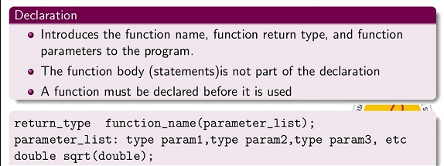
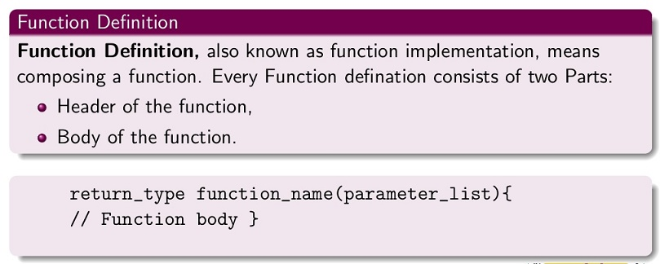
TYPES OF FUNCTIONS
Predefined function are built in functions of the language. Programmer does not need to write these function since they are predefined. Example printf(),scanf()
Userdefined function are defined by programmer. Example main(),int sum(int,int)
FUNCTION
PREDEFINED
USERDEFINED
FUNCTION
DECLARATION
FUNCTION DEFINATION
FUNCTION CALL
Calling a Function
To call a function, we simply need to pass the required parameters along with the function name, and if the function returns a value, then you can store the returned value.
Function name(parameter list);

Slide 5
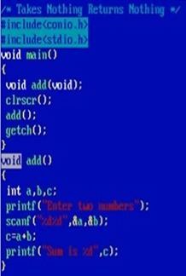
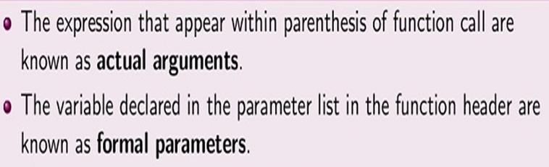
#include <stdio.h>
int sum(int , int); /* Function Declaration*/
void main( void )
{ int s, x, y;
printf(“Enter any two integer value: ”);
scanf(“%d %d”, &x, &y);
s = sum(x,y); /* Function Call*/
printf(“\nThe sum of numbers = %d ”,s);
}
int sum(int a , int b) /* Function Definition*/
{ int c;
c=a+b;
return c;}
Categories of Functions
Takes nothing , returns nothing
Takes something , returns nothing
Takes nothing , returns something's
Takes something , returns something's
Actual Arguments
Actual argument
Formal arguments
Formal Argument

Slide 6
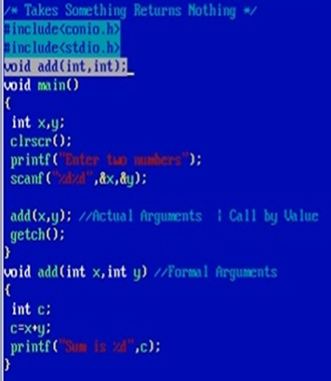
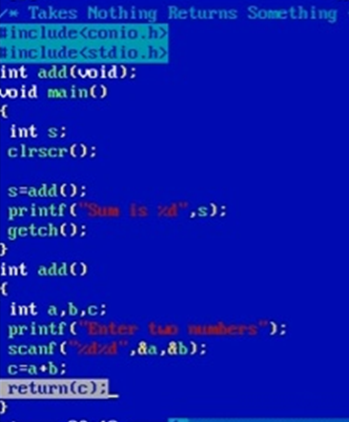
Things to remember
Takes nothing-> variable should declare locally in function definition.
Returns something->one variable of return type should declared in main().

Slide 7
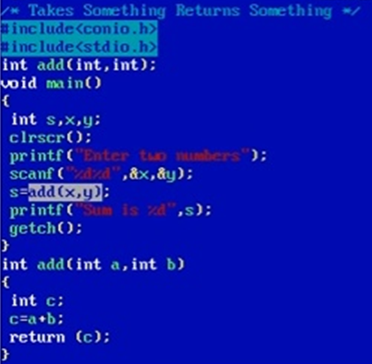
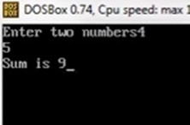
output

Slide 8
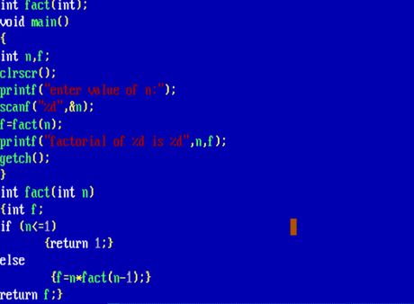
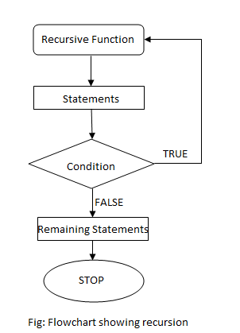

RECURSION
The process of calling a function by itself is called recursion and the function which calls itself is called recursive function.
Fact(5)
5*Fact(4)
5*4*fact(3)
5*4*fact(3)
5*4*3*fact(2)
5*4*3*2*fact(1)
5*4*3*2*1

Slide 9
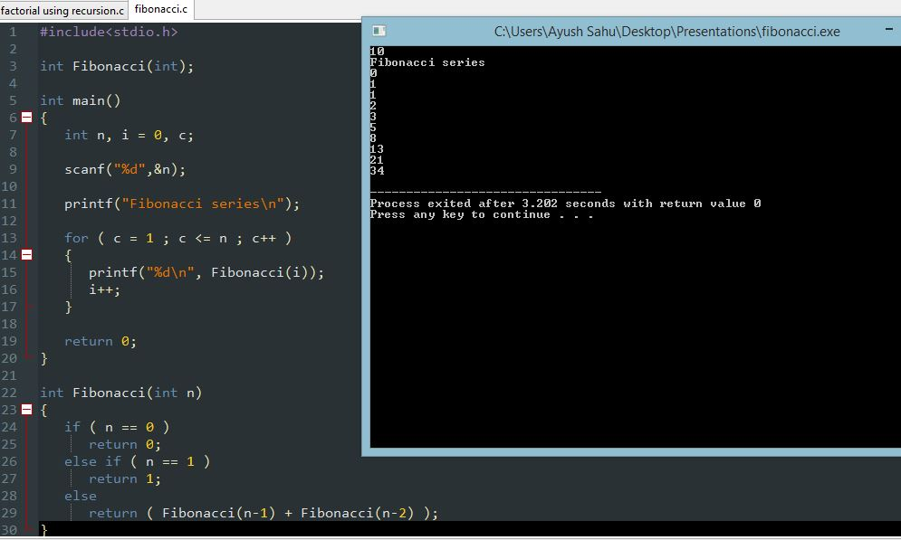

Slide 10
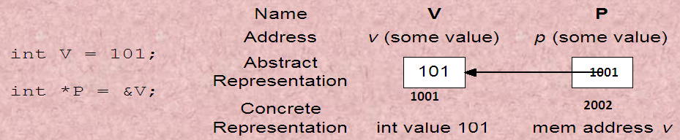
A pointer is a derived data type in C. It is built from one of the fundamental data type available in C. Pointers contain memory addresses as their values and this memory addresses contain another values. int v=101;
Reserve space in memory to hold the integer value. Associate the name i with this memory location. Store the value 101 at this location.
In the first method the ‘value’ of each of the actual arguments in the calling function is copied into corresponding formal arguments of the called function. With this method the changes made to the formal arguments in the called function have no effect on the values of actual arguments in the calling function.
In the second method (call by reference) the addresses of actual arguments in the calling function are copied into formal arguments of the called function. This means that using these addresses we would have an access to the actual arguments and hence we would be able to manipulate them.
FUNCTION CALL
CALL BY VALUE
CALL BY
REFERENCE

Slide 11
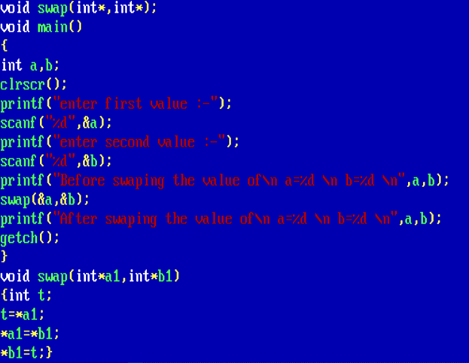
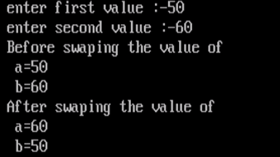

Slide 12
FUNCTION TO POINTER
C does not require that pointers only point to data, it is possible to have pointers to functions. Functions occupy memory locations therefore every function has an address just like each variable
A function pointer is nothing else than a variable, it must be defined as usual. A pointer to a function is declared as follows
type (*fptr) ();
This tell the compiler that fptr is a pointer to a function, which returns type value. The parentthese around *fptr are necessary because there are precedence relationships in declaration just as there are in expressions . We can make a function pointer to point to a specific function by simply assigning the name of the function to the pointer. For example, the statements
int (*funcPointer) (int, int, int);
int firstExample ( int a, int b, int c)
{
printf(“ Welcome to the first example”);
return a+b+c;
}
funcPointer= firstExample; //assignment

